Slide 1

Philosophical Frameworks and Utilitarianism

Slide 2

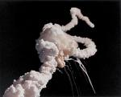
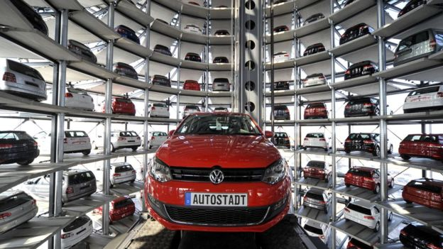
Ethical Frameworks Help Us Find Answers
Notes:
We present philosophical approaches.
Mill (hair sticking out): http://www.utilitarian.net/jsmill/
Kant: http://media-2.web.britannica.com/eb-media/69/99069-004-1D777F95.jpg
Utilitarianism is outcome based. How to compute outcomes?
Utilitarianism is optimization based. Deontological approaches impose constraints. So how does constrained optimization work?
How to behave in a world where other agents are rational? Prisoner’s dilemma.

Slide 3
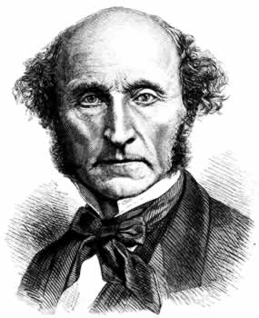
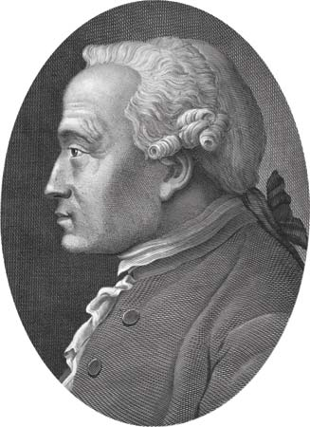
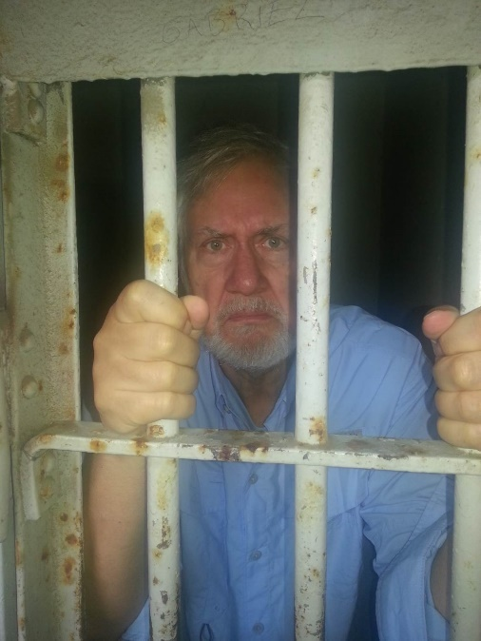
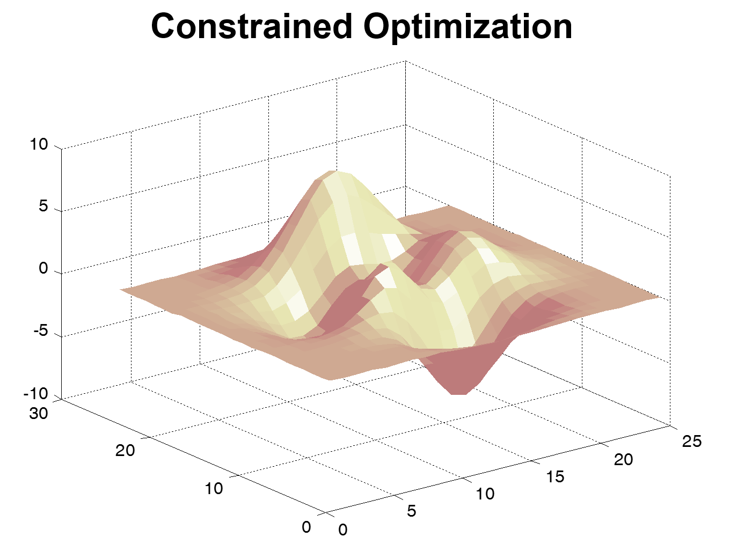
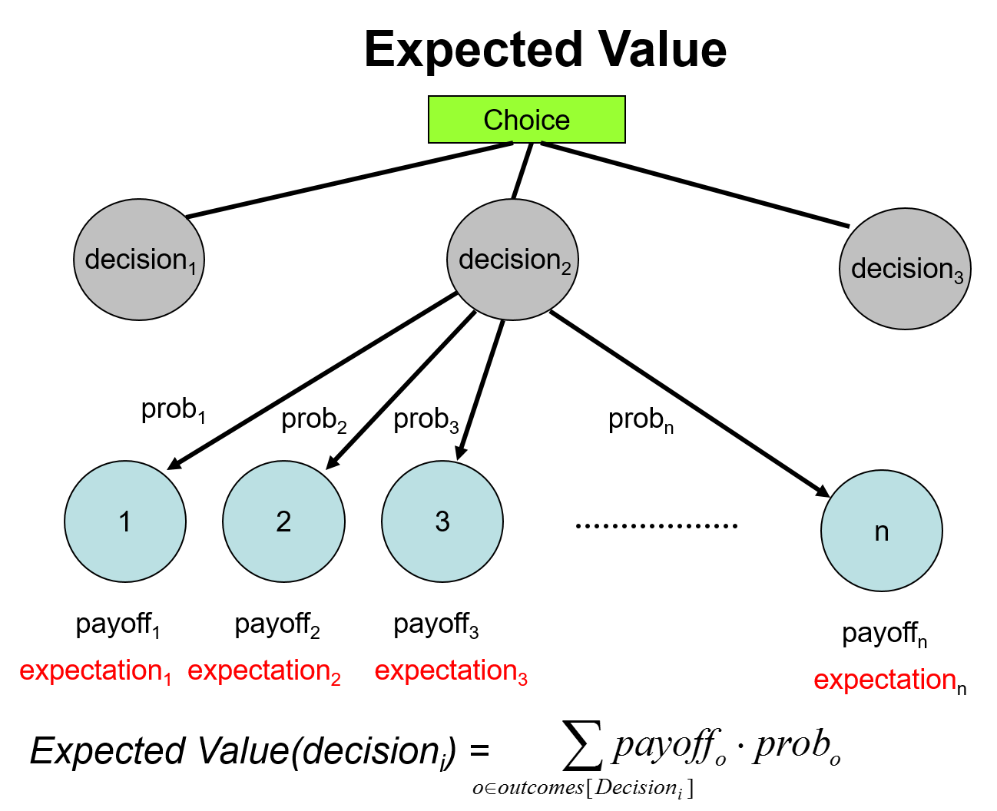
Ethical Frameworks Help Us Find Answers
and Mathematics
Kant and Deontology
Utilitarianism
Prisoner’s Dilemma
Notes:
We present philosophical approaches.
Mill (hair sticking out): http://www.utilitarian.net/jsmill/
Kant: http://media-2.web.britannica.com/eb-media/69/99069-004-1D777F95.jpg
Utilitarianism is outcome based. How to compute outcomes?
Utilitarianism is optimization based. Deontological approaches impose constraints. So how does constrained optimization work?
How to behave in a world where other agents are rational? Prisoner’s dilemma.

Slide 4
Ethical Frameworks Help Us Find Answers
Kant and Deontology
Utilitarianism
Actions are good or bad.
What matters is outcome.
Notes:
We present philosophical approaches.
Mill (hair sticking out): http://www.utilitarian.net/jsmill/
Kant: http://media-2.web.britannica.com/eb-media/69/99069-004-1D777F95.jpg
Utilitarianism is outcome based. How to compute outcomes?
Utilitarianism is optimization based. Deontological approaches impose constraints. So how does constrained optimization work?
How to behave in a world where other agents are rational? Prisoner’s dilemma.

Slide 5
Ethical Frameworks Help Us Find Answers
Utilitarianism
What matters is outcome.
Greatest good for greatest number.
Notes:
We present philosophical approaches.
Mill (hair sticking out): http://www.utilitarian.net/jsmill/
Kant: http://media-2.web.britannica.com/eb-media/69/99069-004-1D777F95.jpg
Utilitarianism is outcome based. How to compute outcomes?
Utilitarianism is optimization based. Deontological approaches impose constraints. So how does constrained optimization work?
How to behave in a world where other agents are rational? Prisoner’s dilemma.

Slide 6
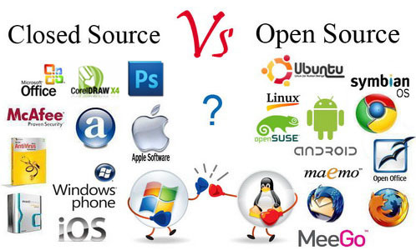
Preference Utilitarianism
Choose actions that allow individuals to maximize good to them.
Notes:
Examples of ways technology is good from a preference utilitarian’s perspective:
We don’t all have to read the same news or watch the same tv. Or have the same privacy settings on Facebook.
IP law protects your work if you want it too. But you don’t have to use it.
http://ianthro.com/microsoft-vs-open-source-software

Slide 7
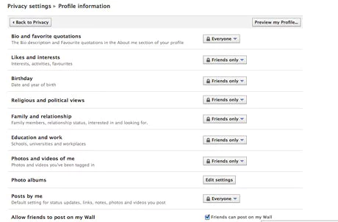
Preference Utilitarianism
Choose actions that allow individuals to maximize good to them.
Notes:
Examples of ways technology is good from a preference utilitarian’s perspective:
We don’t all have to read the same news or watch the same tv. Or have the same privacy settings on Facebook.
https://www.theguardian.com/technology/2010/may/27/how-new-facebook-privacy-settings-work

Slide 8
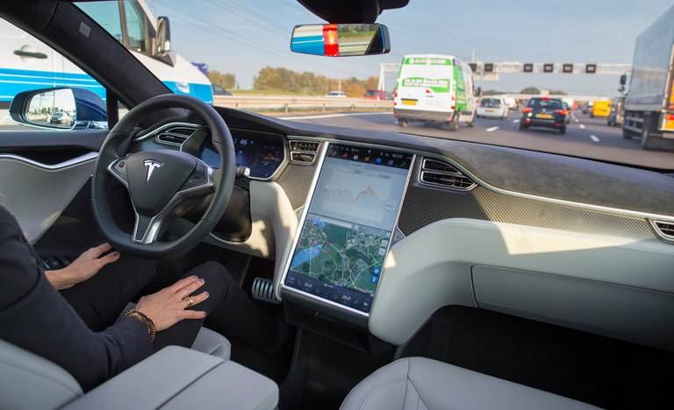
The Risk of Doing Nothing
2016: Self-driving Tesla in accident: 1 person killed
Notes:
http://www.nytimes.com/2016/07/01/business/self-driving-tesla-fatal-crash-investigation.html?_r=0

Slide 9
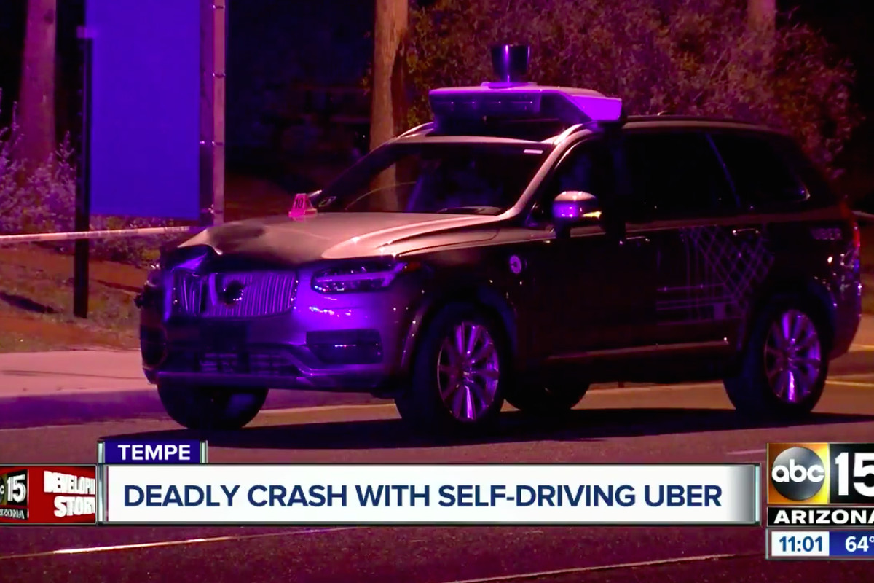
The Risk of Doing Nothing
2018: Self-driving Uber in accident: 1 person killed
Notes:
https://www.theverge.com/2018/6/22/17492320/safety-driver-self-driving-uber-crash-hulu-police-report

Slide 10
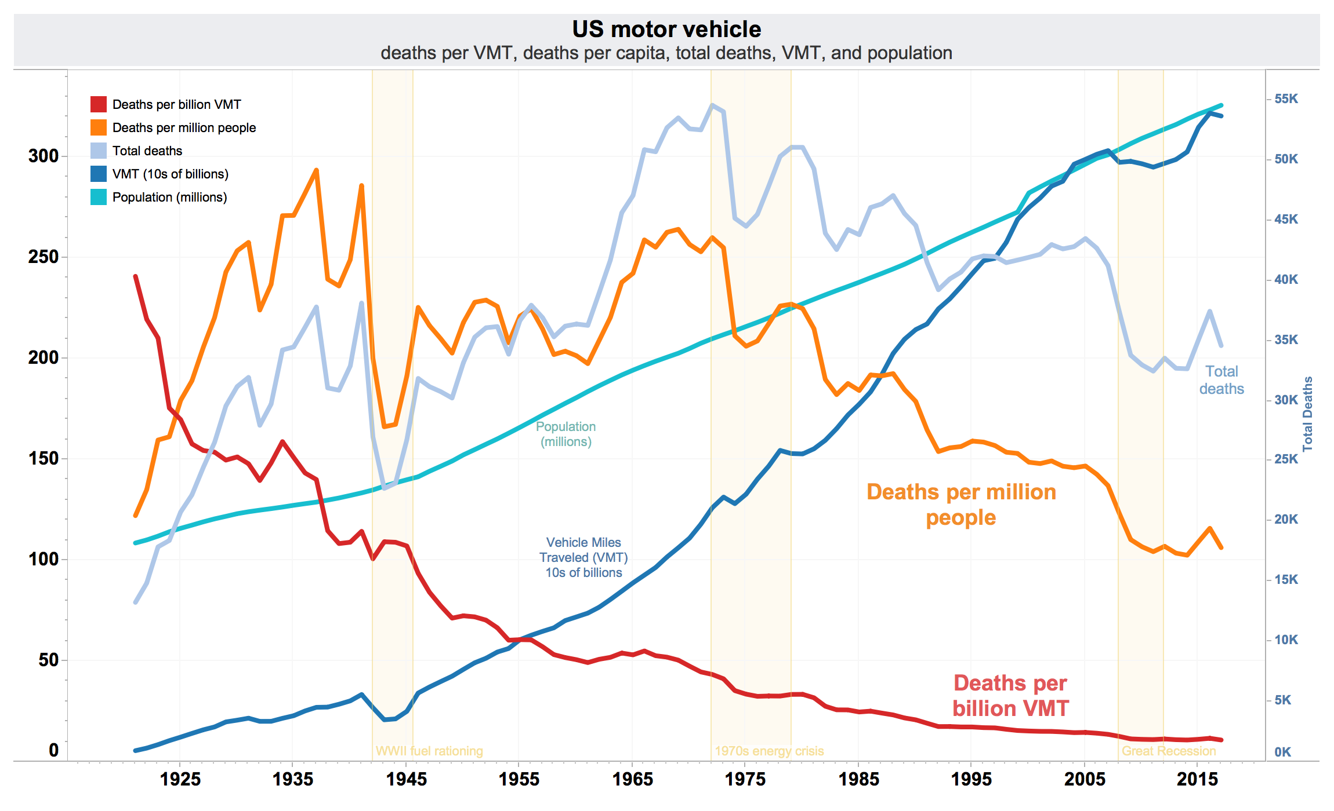
The Risk of Doing Nothing
Human driven cars: people killed per year
Notes:
https://en.wikipedia.org/wiki/List_of_motor_vehicle_deaths_in_U.S._by_year
Why the decline even as passenger miles have increased? http://www.cnn.com/2011/US/04/01/traffic.fatalities/
Experts attribute the change to a variety of reasons, including changes to cars -- such as vehicle rollover protection -- and programs to change driver behavior -- such as campaigns addressing drunk driving, distracted driving and seat belt use. Laws aimed at young people also likely have had an impact, notably older minimum drinking ages and graduated drivers' licenses.

Slide 11
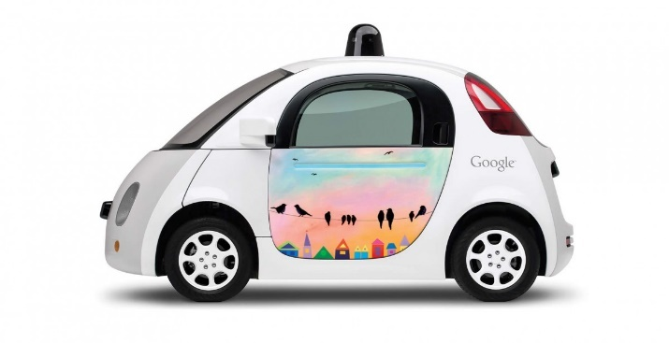
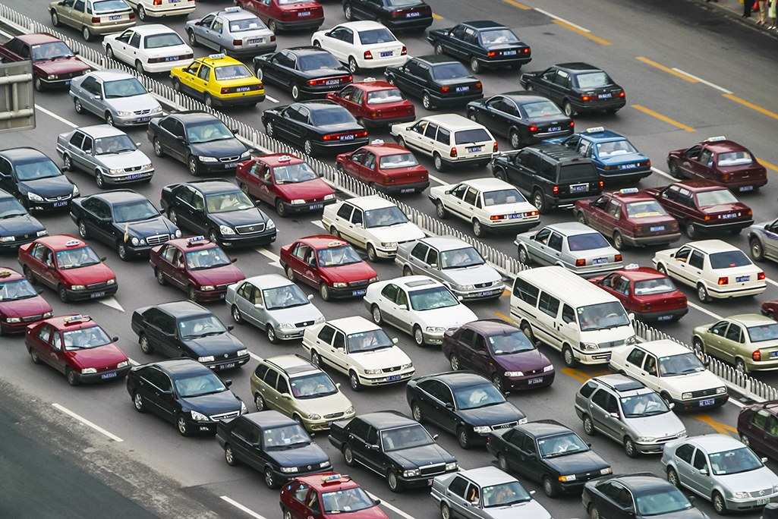
The Risk of Doing Nothing – An Ethical Issue?
Notes:
Yes. Doing nothing, when something is possible, is no different from killing all those people.
https://medium.com/@DonotInnovate/73-mind-blowing-implications-of-a-driverless-future-58d23d1f338d
https://en.wikipedia.org/wiki/List_of_motor_vehicle_deaths_in_U.S._by_year
https://assets.wired.com/photos/w_1025/wp-content/uploads/2014/06/traffic-jam-getty.jpg
http://www.forbes.com/sites/brookecrothers/2015/11/12/google-is-leader-in-revolutionary-self-driving-cars-says-ihs/#1fc314e3e6b1

Slide 12
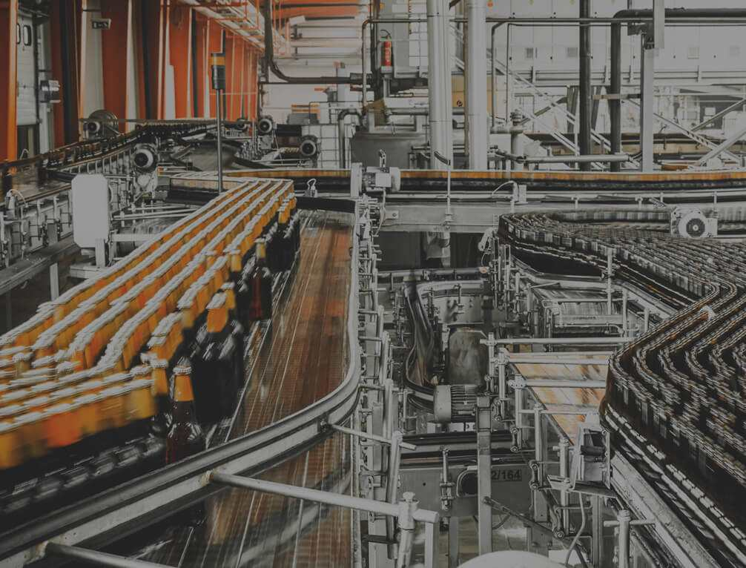
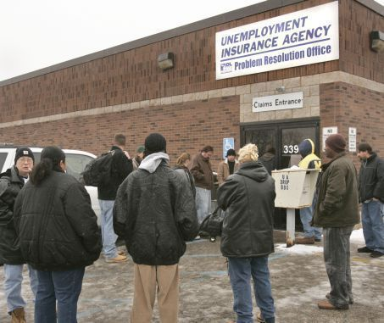
Implementing Utilitarianism
Can we trade off:
the good of the many
for
the suffering of a few?
Notes:
Or we can implement a new technology that makes great stuff cheap for everyone but puts 10% of the population out of work?
Coors bottling plant – no workers visible. Keeps cost of beer down.
http://visitgolden.com/wp-content/uploads/2016/03/CoorsCompany.jpg
But people out of work.
http://media.mlive.com/businessreview/western_impact/photo/unemployment-line-0febebd9276aed6b.jpg

Slide 13

Another Example of the Tradeoff
X has written a hit song.
You can put the song up on the web and distribute it to all the fans.
Millions of people win.
One person loses.
Notes:
http://www.freevector.com/music-piracy

Slide 14
Implementing Utilitarianism
Choose the action that results in the greatest total
To do this, we need to:
Define what’s good.
Find a way to measure it.
good.
utility.

Slide 15
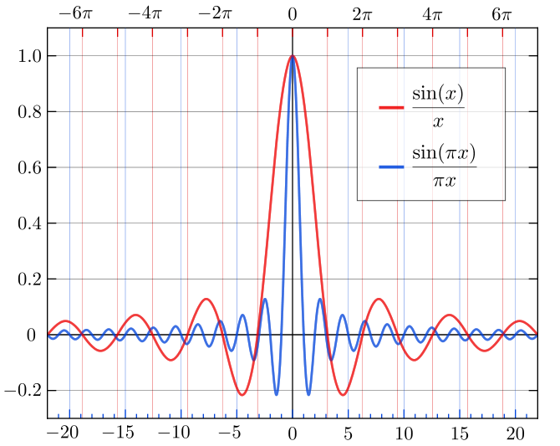
Implementing Utilitarianism
ACT:
RULE:

Slide 16

Implementing Utilitarianism
What happens when we can’t predict outcomes with certainty?
Notes:
https://dlpng.com/png/281126

